Slide 1
Pure” languages: The Pure language is a successor of the equational programming language Q,
Pure” languages:
  Relational algebra
  Tuple relational calculus: A tuple is a single element of relation. In database terms, it is a row. (is a non-procedural query language)
  Domain relational calculus: A domain is equivalent to column data type and any constraints on the value of data. (non-procedural query language equivalent in power to Tuple Relational Calculus.)
  Relational Algebra is a procedural query language. Relational algebra mainly provides a theoretical foundation for relational databases and SQL.
    2. The Tuple Relational Calculus (TRC) is used to select tuples from a relation. The tuples with specific range values, tuples with certain attribute values, and so on can be selected.
    3. The Domain Relational Calculus (DRC) employs a list of attributes from which to choose based on the condition. It’s similar to TRC, but instead of selecting entire tuples, it selects attributes.
  Procedural versus non-procedural, or declarative

Slide 2
Procedural versus non-procedural, or declarative
Procedural Language: In procedural languages, the program code is written as a sequence of instructions. User has to specify “what to do” and also “how to do” (step by step procedure). These instructions are executed in the sequential order. These instructions are written to solve specific problems.
  Examples of Procedural languages:
  FORTRAN, COBOL, ALGOL, BASIC, C and Pascal.
Non-Procedural Language: In the non-procedural languages, the user has to specify only “what to do” and not “how to do”. It is also known as an applicative or functional language. It involves the development of the functions from other functions to construct more complex functions.
  Examples of Non-Procedural languages:
  SQL, PROLOG, LISP.

Slide 3
Procedural versus non-procedural, or declarative
What is the difference between procedural and non-procedural statements?
  Procedural Languages: Code in procedural languages is typically organized into functions or procedures. Each function has a specific task, and the program's execution flows through these functions.
  Non-Procedural Languages: Code in non-procedural languages focuses on defining relationships and constraints.
What is an example of a declarative language?
  Three classic examples of declarative programming languages are SQL, HTML, and CSS.

Slide 4
Declarative language
Declarative programming is where you say what you want without having to say how to do it. With procedural programming, you have to specify exact steps to get the result.
What are the best declarative languages?
  Common declarative languages include those of database query languages (e.g., SQL, XQuery), regular expressions, logic programming (e.g. Prolog, Datalog, answer set programming), functional programming, configuration management, and algebraic modeling systems.

Slide 5
Relational Query Languages
The above 3 pure languages are equivalent in computing power.
We will concentrate in this chapter on relational algebra
  Not Turing-machine equivalent
  Consists of 6 basic operations

Slide 6
Relational Algebra
A procedural language consisting of a set of operations that take one or two relations as input and produce a new relation as their result.
Six basic operators:
  select: σ
  project: ∏
  union: ∪
  set difference: –
  Cartesian (ديكارتي) product: x
  rename: ρ

Slide 7
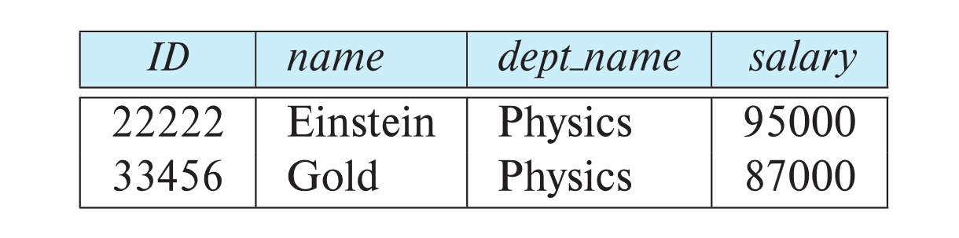
Select Operation: return rows based on condition
The select operation selects tuples that satisfy a given predicate.
Notation: σ _{p} (r)
p is called the selection predicate
Example: select those tuples of the instructor relation where the instructor is in the “Physics” department.
  Query
  σ _{dept_name=“Physics”} (instructor)
  Result

Slide 8
Select Operation (Cont.): conditions..
We allow comparisons using
=, ≠, >, ≥, <, ≤
in the selection predicate.
We can combine several predicates into a larger predicate by using the connectives:
∧ (and), ∨ (or), ¬ (not)
Example: Find the instructors in Physics with a salary greater $90,000, we write:
σ _{dept_name=“Physics”} ∧ _{salary >} _{90,000} (instructor)
The select predicate may include comparisons between two attributes.
  Example, find all departments whose name is the same as their building name:
  σ _{dept_name=building} (department)

Slide 9
Project Operation: returns columns (attributes)
A unary operation that returns its argument relation, with certain attributes left out.
          Notation:
          ∏ _{A1,A2,A3 ….Ak} (r)
where A₁, A₂, …, A_{k} are attribute names and r is a relation name.
The result is defined as the relation of k columns obtained by erasing the columns that are not listed
  Duplicate rows removed from result, since relations are sets

Slide 10
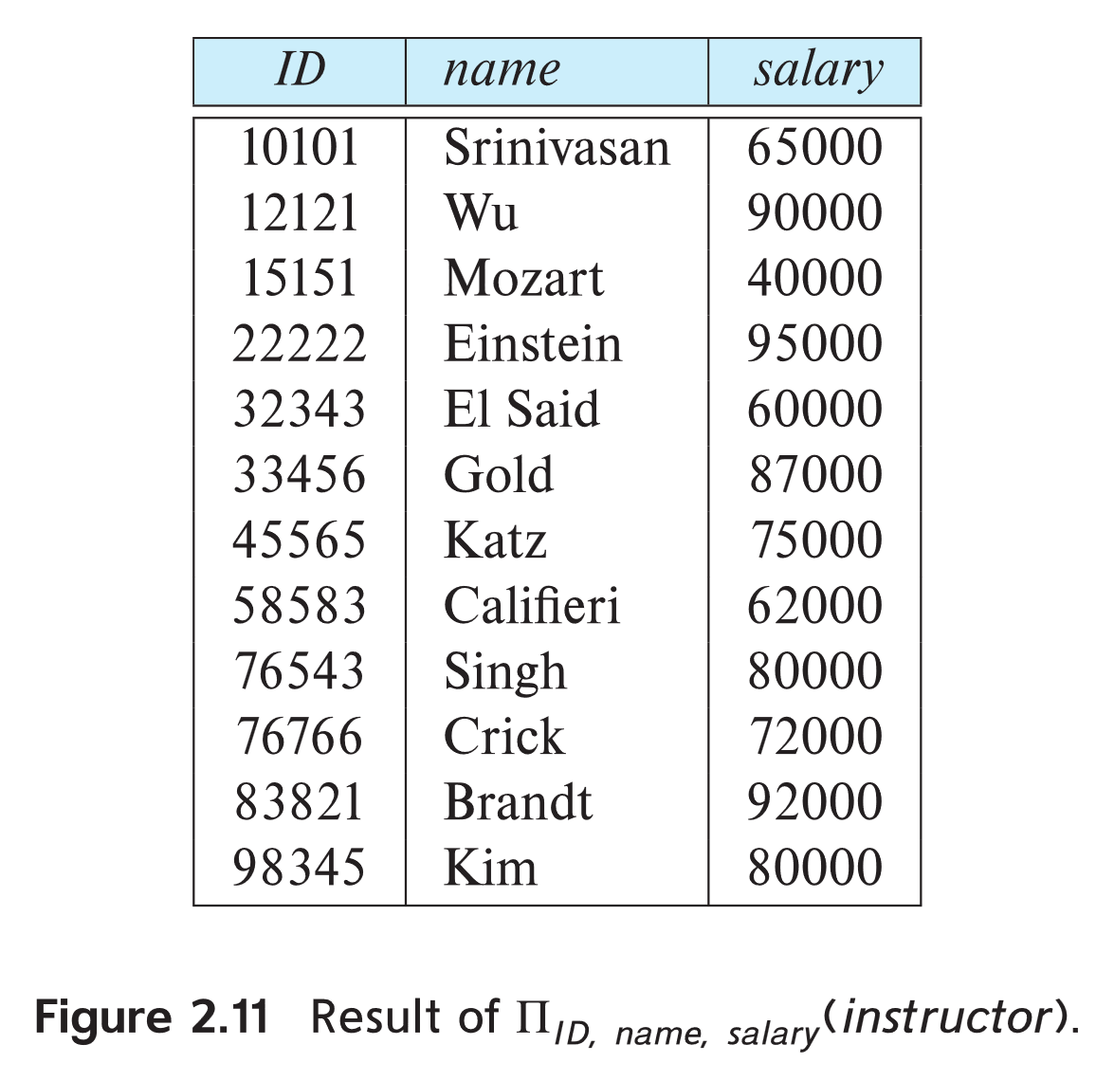
Project Operation Example
Example: eliminate the dept_name attribute of instructor
Query:
∏_{ID, name, salary} (instructor)
Result:

Slide 11
Composition of Relational Operations: like nested: find all.. condition
The result of a relational-algebra operation is relation and therefore of relational-algebra operations can be composed together into a relational-algebra expression.
Example: Consider the query -- Find the names of all instructors in the Physics department.
∏_{name}(σ _{dept_name} _{=“Physics”} (instructor))
Instead of giving the name of a relation as the argument of the projection operation, we give an expression that evaluates to a relation.

Slide 12
Cartesian-Product Operation: returns all the rows in all the tables
The Cartesian-product operation (denoted by X) allows us to combine information from any two relations.
    Cartesian Product in DBMS is an operation used to merge columns from two relations.
    returns all the rows in all the tables listed in a query
  Example: the Cartesian product of the relations instructor and teaches is written as:
instructor X teaches
We construct a tuple of the result out of each possible pair of tuples: one from the instructor relation and one from the teaches relation (see next slide)
Since the instructor ID appears in both relations we distinguish between these attribute by attaching to the attribute the name of the relation from which the attribute originally came.
  instructor.ID
  teaches.ID

Slide 13
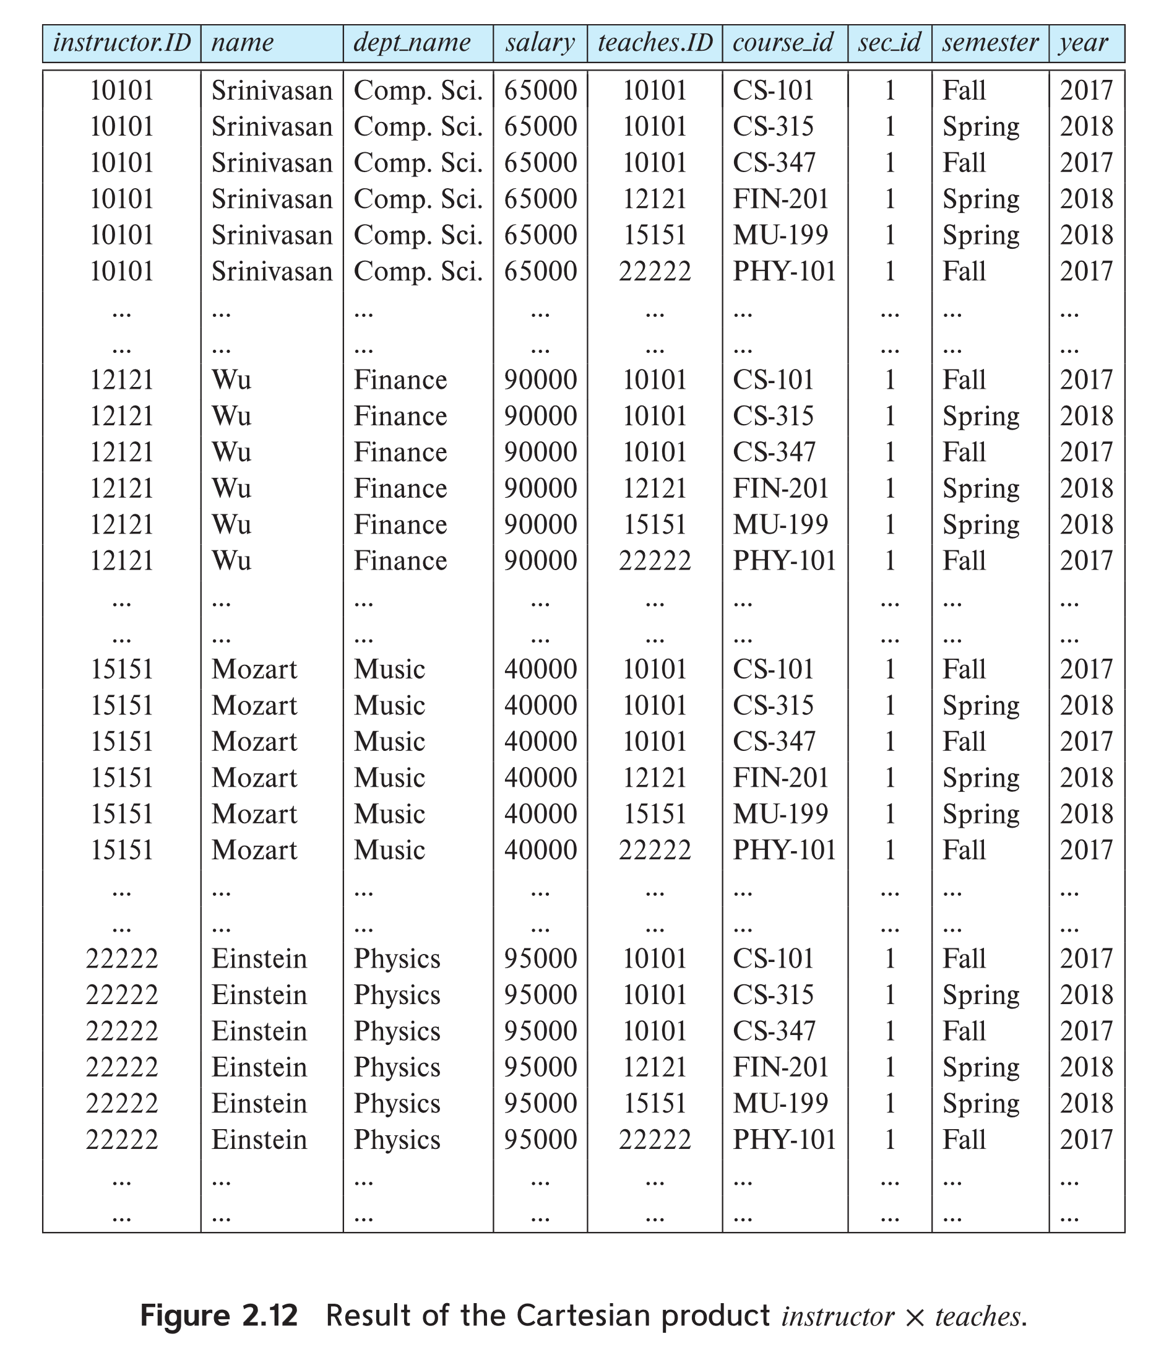
The instructor X teaches table

Slide 14
Join Operation
The Cartesian-Product
instructor X teaches
associates every tuple of instructor with every tuple of teaches.
  Most of the resulting rows have information about instructors who did NOT teach a particular course.
To get only those tuples of “instructor X teaches “ that pertain to instructors and the courses that they taught, we write:
σ _{instructor.id = teaches.id} ((instructor x teaches ))
  We get only those tuples of “instructor X teaches” that pertain to instructors and the courses that they taught.
The result of this expression, shown in the next slide

Slide 15
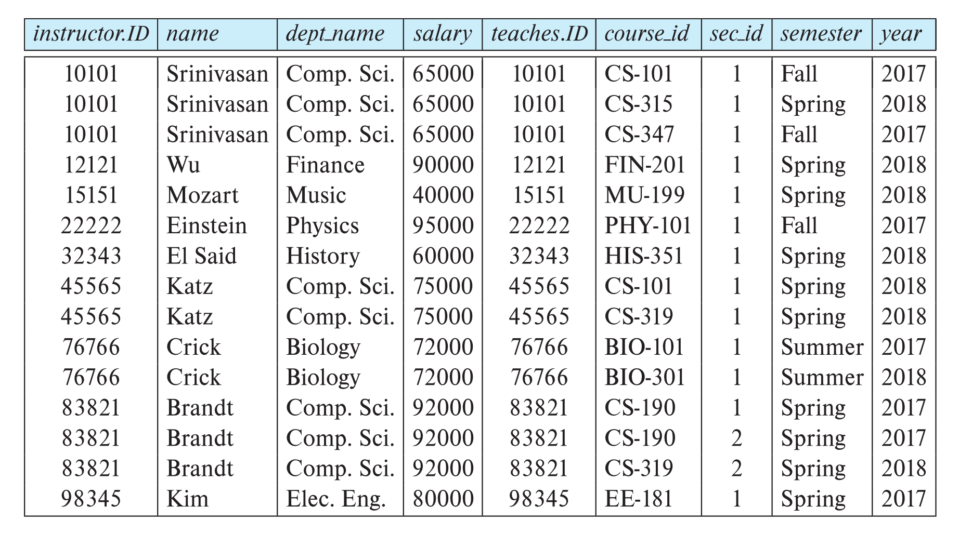
Join Operation (Cont.)
The table corresponding to:
σ _{instructor.id = teaches.id} (instructor x teaches))

Slide 16
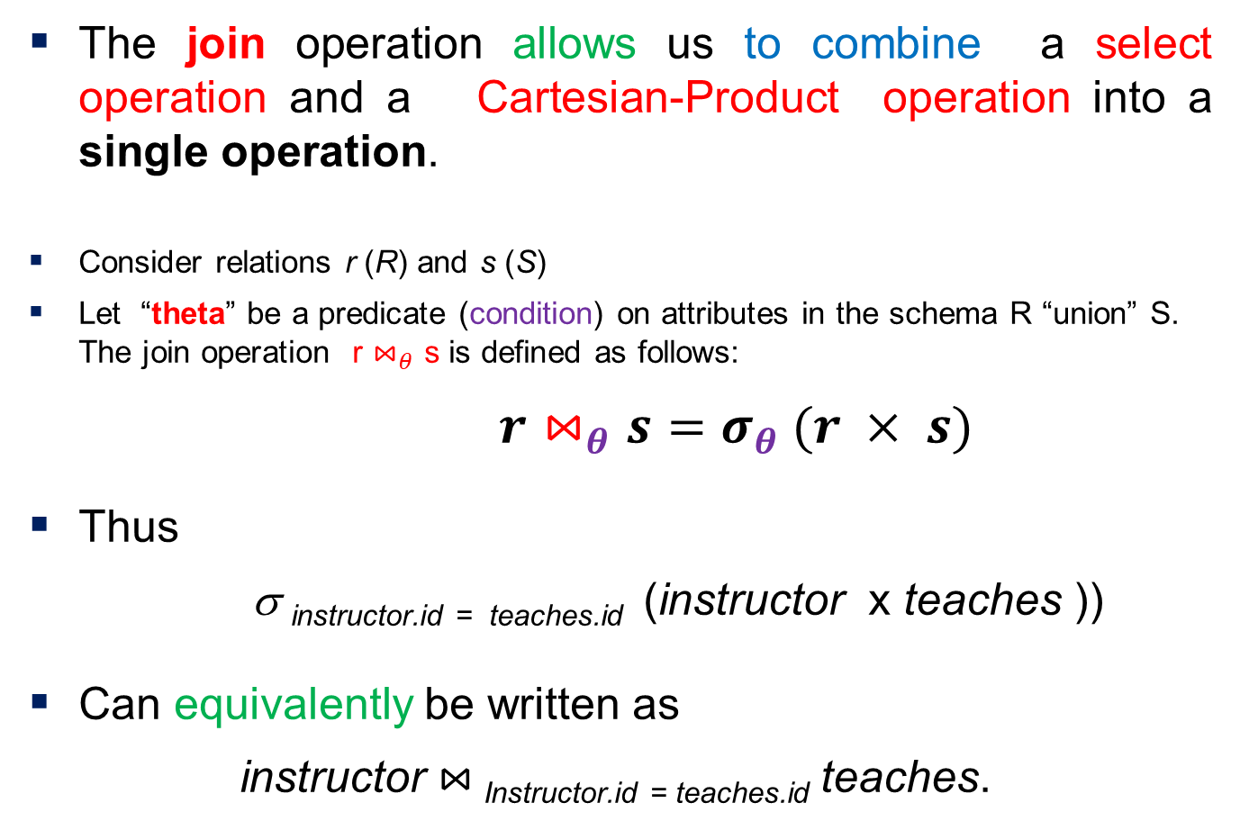
Join Operation (Cont.)
The join operation allows us to combine a select operation and a Cartesian-Product operation into a single operation.
Consider relations r (R) and s (S)
Let “theta” be a predicate (condition) on attributes in the schema R “union” S. The join operation r $⋈_{θ}$ s is defined as follows:
$r⋈_{θ}s=σ_{θ} (r × s)$
Thus
σ _{instructor.id = teaches.id} (instructor x teaches ))
Can equivalently be written as
instructor $⋈_{ }$_{Instructor.id = teaches.id} teaches.

Slide 17
Union Operation: combine result of two operations: All… OR
The union operation allows us to combine two relations
Notation: r ∪ s
A union combines the rows of the two relations and outputs a new relation that has both input relations' rows in it.
For r ∪ s to be valid.
1. r, s must have the same arity (same number of attributes)
2. The attribute domains must be compatible (example: 2nd
  column of r deals with the same type of values as does the
  2nd column of s)
Example: to find all courses taught in the Fall 2017 semester, or in the Spring 2018 semester, or in both
∏_{course_id} (σ _{semester=“Fall” Λ year=2017} (section)) ∪
∏_{course_id} (σ _{semester=“Spring” Λ year=2018} (section))

Slide 18
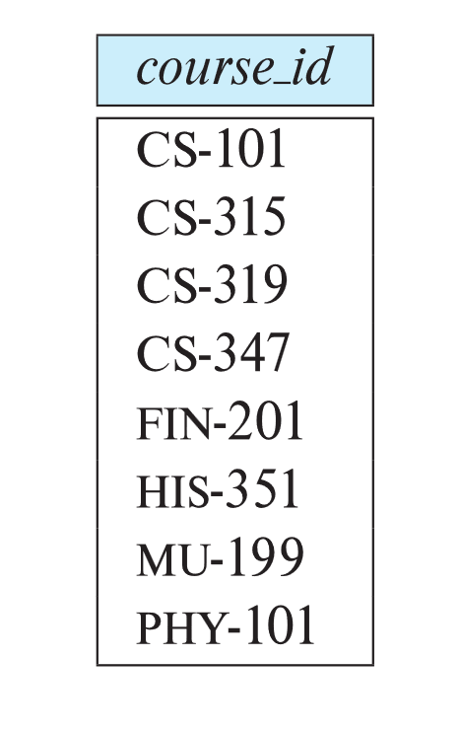
Union Operation (Cont.)
Result of:
∏_{course_id} (σ _{semester=“Fall” Λ year=2017} (section)) ∪
∏_{course_id} (σ _{semester=“Spring” Λ year=2018} (section))

Slide 19
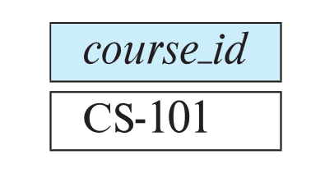
Set-Intersection Operation: result of two operations: All… AND
The set-intersection operation allows us to find tuples that are in both the input relations.
Notation: r ∩ s
Assume:
  r, s have the same arity
  attributes of r and s are compatible
Example: Find the set of all courses taught in both the Fall 2017 and the Spring 2018 semesters.
∏_{course_id} (σ _{semester=“Fall” Λ year=2017} (section)) ∩
∏_{course_id} (σ _{semester=“Spring” Λ year=2018} (section))
  Result

Slide 20

Set Difference Operation: result of two operations: All… in…, but not in
The set-difference operation allows us to find tuples that are in one relation but are not in another.
Notation r – s
Set differences must be taken between compatible relations.
  r and s must have the same arity
  attribute domains of r and s must be compatible
Example: to find all courses taught in the Fall 2017 semester, but not in the Spring 2018 semester:
∏_{course_id} (σ _{semester=“Fall” Λ year=2017} (section)) −
∏_{course_id} (σ _{semester=“Spring” Λ year=2018} (section))

Slide 21
The Assignment Operation
It is convenient at times to write a relational-algebra expression by assigning parts of it to temporary relation variables.
The assignment operation is denoted by ← and works like assignment in a programming language.
Example: Find all instructor in the “Physics” and Music department.
Physics ← σ _{dept_name=“Physics”} (instructor)
  Music ← σ _{dept_name=“Music”} (instructor)
  Physics ∪ Music
With the assignment operation, a query can be written as a sequential program consisting of a series of assignments followed by an expression whose value is displayed as the result of the query.
← Assignment must always be made to a temporary relation variable. An extension of the join operation that avoids loss of information.

Slide 22
The Rename Operation
The results of relational-algebra expressions do not have a name that we can use to refer to them. The rename operator, ρ , is provided for that purpose.
The expression:
ρ_{x} (E)
returns the result of expression E under the name x
where the symbol ‘ρ’ is used to denote the RENAME operator and E is the result of the sequence of operation or expression which is saved with the name X.
Another form of the rename operation:
ρ_{x(A1,A2, .. An)} (E)

Slide 23
Rename Operation.. Examples
Example-1: Query to rename the attributes Name, Age of table Department to A,B.
      ρ (A, B) (Department)
Example-2: Query to rename the table name Project to Pro and its attributes to P, Q, R.
ρ Pro(P, Q, R) (Project)
Example-3: Query to rename the first attribute of the table Student with attributes A, B, C to P.
ρ (P, B, C) (Student)

Slide 24
Equivalent Queries
There is more than one way to write a query in relational algebra.
Example: Find information about courses taught by instructors in the Physics department with salary greater than 90,000
  Query 1
  σ _{dept_name=“Physics”} ∧ _{salary > 90,000} (instructor)
  Query 2
  σ _{dept_name=“Physics”} (σ _{salary > 90.000} (instructor))
The two queries are not identical; they are, however, equivalent -- they give the same result on any database.

Slide 25
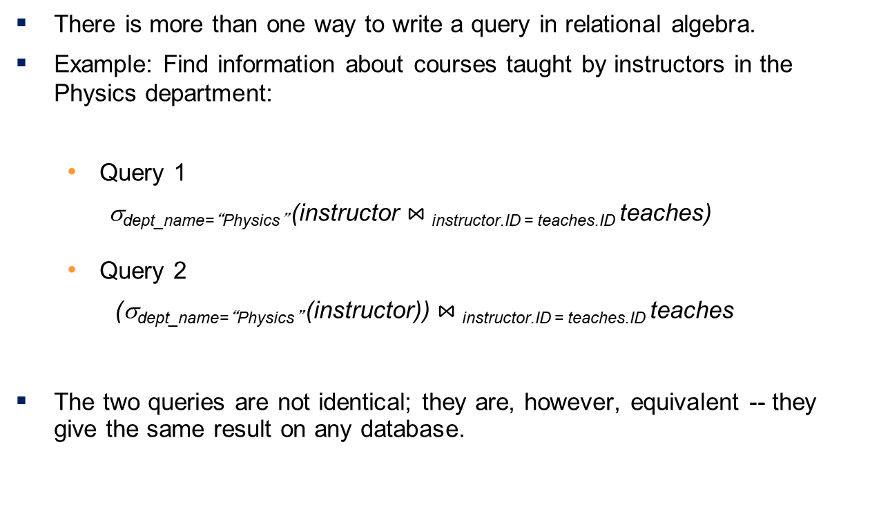
Equivalent Queries
There is more than one way to write a query in relational algebra.
Example: Find information about courses taught by instructors in the Physics department:
  Query 1
  σ_{dept_name=“Physics”} (instructor $⋈_{ }$_{instructor.ID = teaches.ID} teaches)
  Query 2
  (σ_{dept_name=“Physics”} (instructor)) $⋈_{ }$_{instructor.ID = teaches.ID} teaches
The two queries are not identical; they are, however, equivalent -- they give the same result on any database.

Slide 26
End of Chapter 2

